Slide 1
Stock data analysis using news data articles and sentiments
Rohith Reddy Kathi
Ravi Teja Nidanampally
Harshitha Challa
Vinay Chandra Tadishetty

Slide 2
Work Distribution
Rohith Reddy Kathi: worked in researching the project and in writing code
Harshitha Challa: worked in writing code and in preparing presentation
Ravi Teja Nidanampally: worked in collecting datasets and in writing code
Vinay Chandra Tadishetty: worked in writing code and in preparing presentation

Slide 3
Motivation
This project is about taking non quantifiable data such as financial news articles about a company and predicting its future stock trend with news sentiment classification. Assuming that news articles have impact on stock market, this is an attempt to study relationship between news and stock trend. To show this, we have created a model which depict polarity of news articles being positive or negative

Slide 4
Objective
In the finance field, stock market and its trends are extremely volatile in nature. It attracts researchers to capture the volatility and predicting its next moves. Investors and market analysts study the market behavior and plan their buy or sell strategies accordingly. As stock market produces large amount of data every day, it is very difficult for an individual to consider all the current and past information for predicting future trend of a stock. This research is an attempt to build a model that predicts news polarity which may affect changes in stock trends. In other words, check the impact of news articles on stock prices.

Slide 5

Data Source
We are using Kaggle data sets for this Project.
https://www.kaggle.com/aaron7sun/stocknews
https://www.kaggle.com/aaron7sun/stocknews?select=upload_DJIA_table.csv

Slide 6

Tools
Google Colab

Slide 7
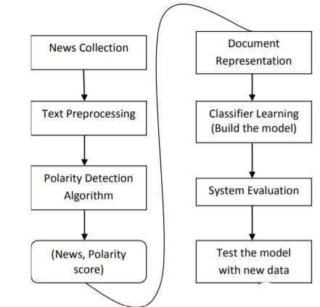
Work Flow

Slide 8
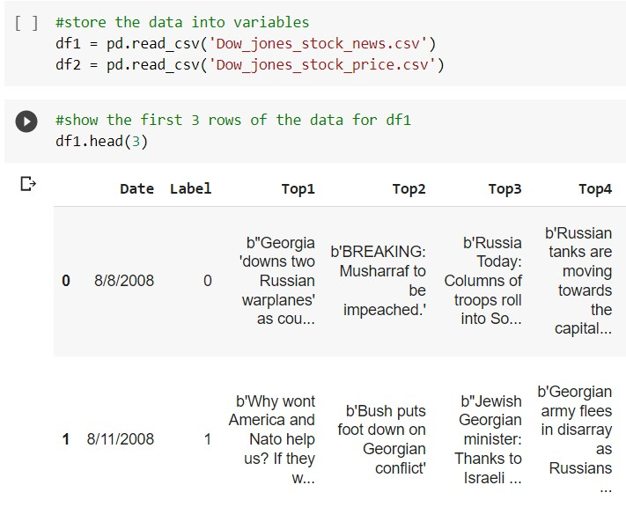
Code Snippet

Slide 9
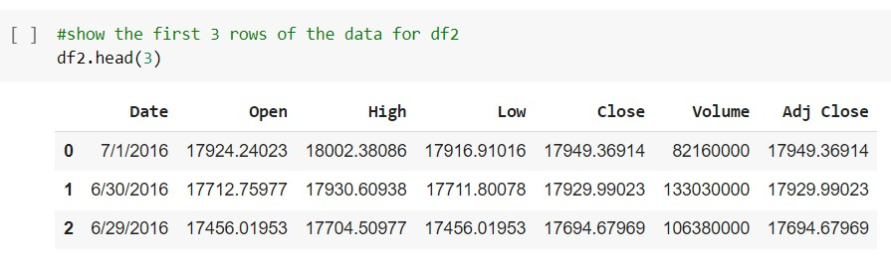
Code Snippet

Slide 10
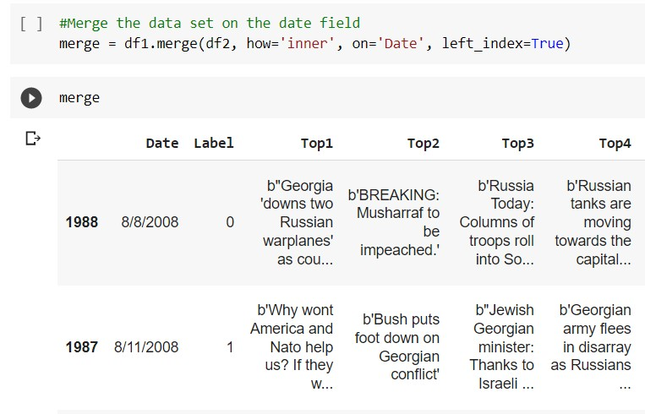
Code Snippet

Slide 11
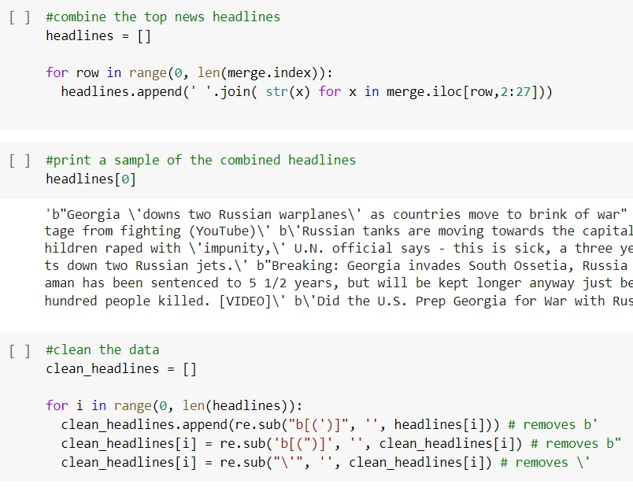
Code Snippet

Slide 12
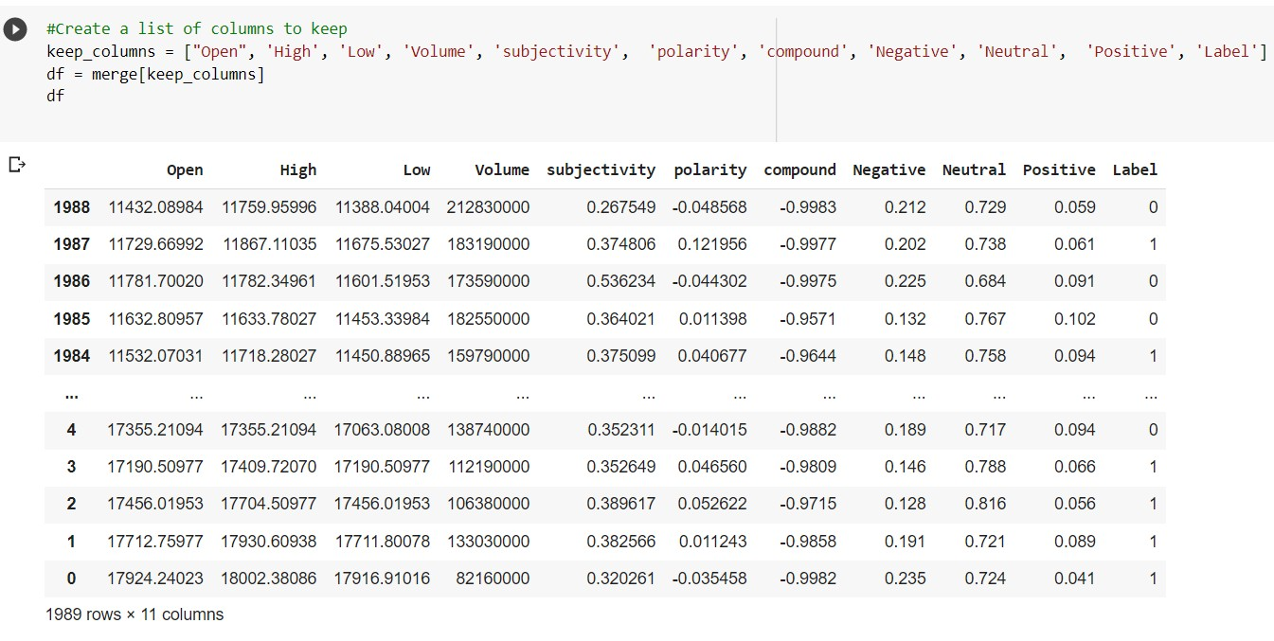
Code Snippet-Output

Slide 13
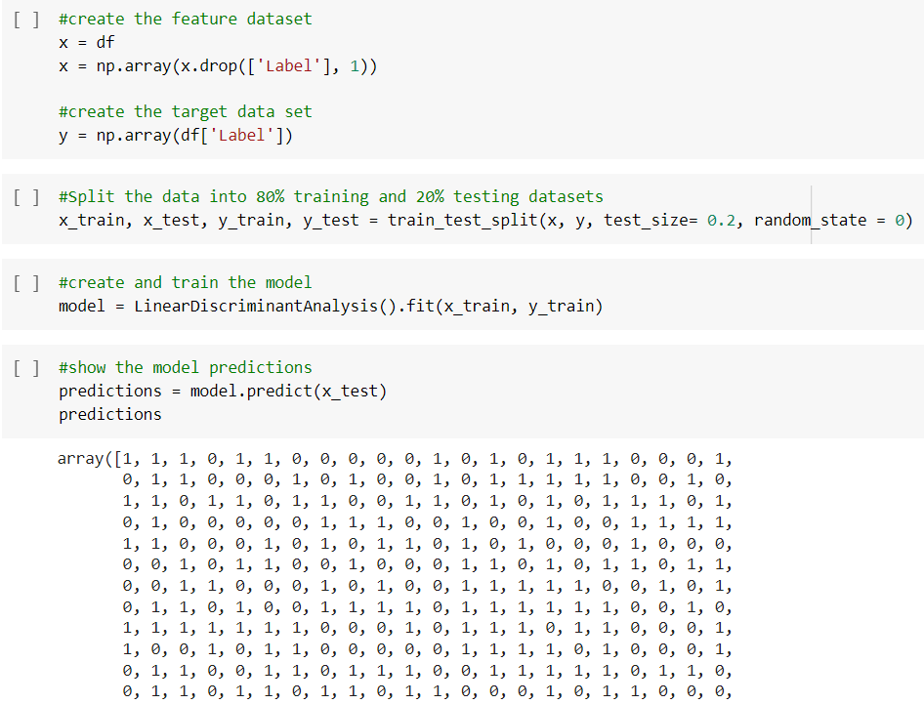
Code Snippets-Output

Slide 14
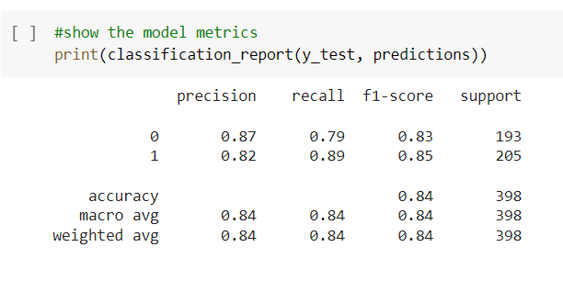
Code Snippet-Output

Slide 15
Github link -
https://github.com/HarshithaChalla29/BDA-project

Slide 16
References
https://www.wsj.com/news/business?gclid=Cj0KCQiAqbyNBhC2ARIsALDwAsC0GzKEtIoolwTAW5Q1jltz2bc3FCpK9h0uUuAuosBx8ks62RctNYoaAkxDEALw_wcB&mod=djmc_DGBus&gclsrc=aw.ds&ef_id=Ya-puwAAAKeX6wPv:20211208013501:s
https://medium.com/@kala.shagun/stock-market-prediction-using-news-sentiments-f9101e5ee1f4
https://ieeexplore.ieee.org/document/8848203
https://www.nature.com/articles/s41598-021-82338-6

Slide 17



16 | © Infoblox Inc. All rights reserved.

